Slide 1

COMPUTER NETWORKS (BCSC 0008)
Copyright content, use only with the written permission of presenter mentioned
DATA LINK LAYER FLOW CONTROL- STOP & WAIT ARQ

Slide 2
Text and Reference Books
Text Books:
Fourouzan B. A. (2004), “Data Communication and Networking”, 4th Edition, McGraw-Hill.
References:
Kurose, J. F. and Ross K. W. (2005), “Computer Networking: A Top-Down Approach Featuring the Internet”, 3rd Edition, Addison-Wesley.
A. S. Tanenbaum (2006), “Computer Networks”, 2nd Edition, Prentice Hall India.

Slide 3
Previous discussed topics:
Data Link Layer - FRAMING
Now we will discuss:
Flow Control
Sliding Window Mechanism

Slide 4
FLOW CONTROL
The most important responsibilities of the data link layer are flow control and error control. Collectively, these functions are known as data link control.
Flow control refers to a set of procedures used to restrict the amount of data that the sender can send before waiting for acknowledgment.

Slide 5
FLOW CONTROL
Flow control coordinates the amount of data that can be sent before receiving acknowledgement
It is one of the most important functions of data link layer.
Flow control is a set of procedures that tells the sender how much data it can transmit before it must wait for an acknowledgement from the receiver.
Receiver has a limited speed at which it can process incoming data and a limited amount of memory in which to store incoming data.

Slide 6
FLOW CONTROL
Receiver must inform the sender before the limits are reached and request that the transmitter to send fewer frames or stop temporarily.
Since the rate of processing is often slower than the rate of transmission, receiver has a block of memory (buffer) for storing incoming data until they are processed.

Slide 7
FLOW CONTROL
Flow control deals with throttling the speed of the sender to match that of the receiver.
Two Approaches:
feedback-based flow control, the receiver sends back information to the sender giving it permission to send more data or at least telling the sender how the receiver is doing
rate-based flow control, the protocol has a built-in mechanism that limits the rate at which senders may transmit data, without using feedback from the receiver.
Various Flow Control schemes uses a common protocol that contains well-defined rules about when a sender may transmit the next frame. These rules often prohibit frames from being sent until the receiver has granted permission, either implicitly or explicitly.

Slide 8
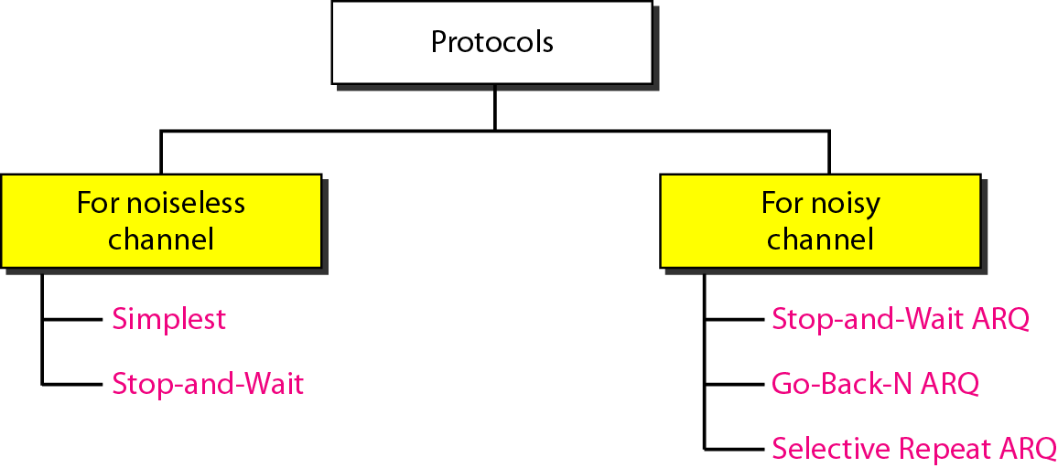

Slide 9
NOISELESS CHANNELS
Let us first assume we have an ideal channel in which no frames are lost, duplicated, or corrupted. We introduce two protocols for this type of channel.
Simplest Protocol Stop-and-Wait Protocol

Slide 10
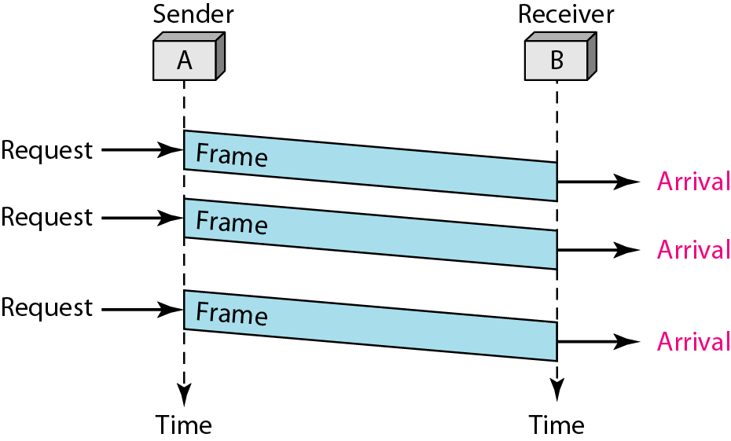
Simplest Protocol

Slide 11
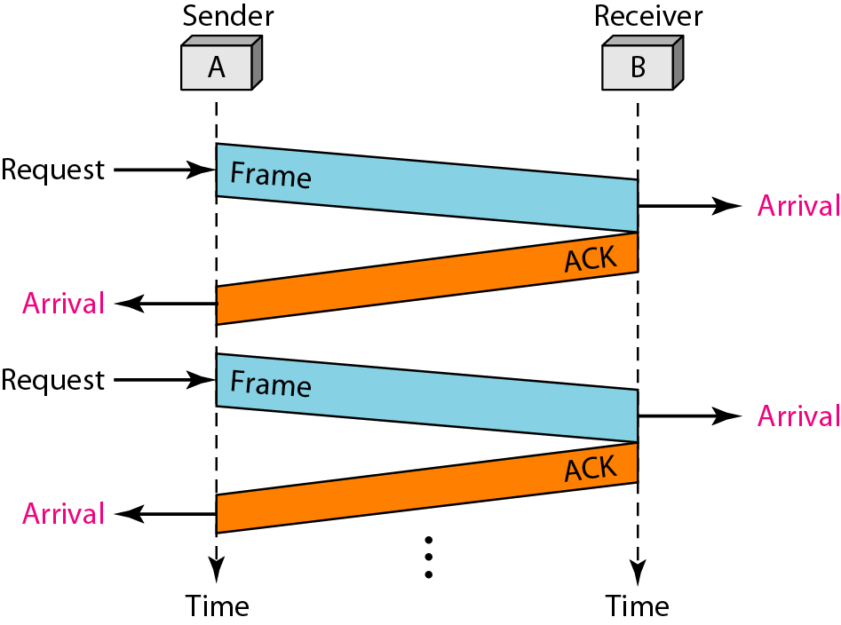
Stop and Wait

Slide 12
NOISY CHANNELS
Although the Stop-and-Wait Protocol gives us an idea of how to add flow control to its predecessor, noiseless channels are nonexistent. We discuss three protocols in this section that use error control.
Stop-and-Wait Automatic Repeat Request Go-Back-N Automatic Repeat Request Selective Repeat Automatic Repeat Request

Slide 13
NOTE:
Round Trip Time( RTT) : Time taken by frame to travel from sender to receiver + Time taken by corresponding frame ACK to travel from receiver to sender.
Thus, RTT = 2* Tp ( Twice Propagation Time)
For any frame to successfully received on receiver site, The timer for that frame must be set to 2Tp (Propagation Time) i.e, RTT ( One Tp for frame transmission and one Tp for corresponding ACK to arrive)

Slide 14
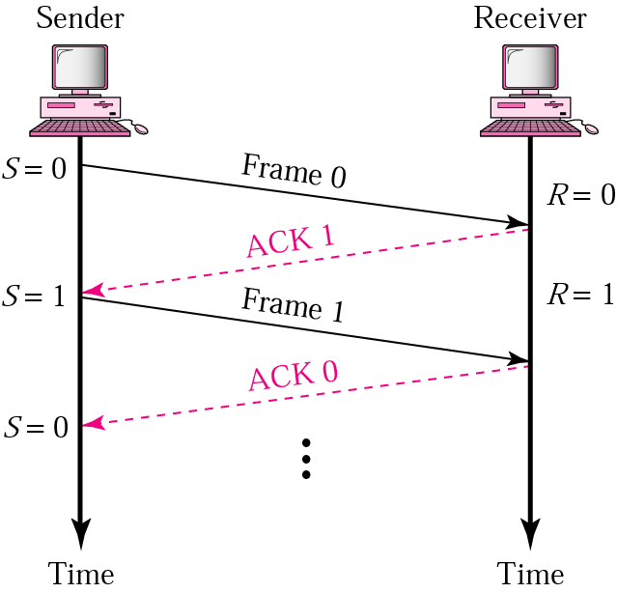
Stop-and-Wait ARQ
Sender keeps a copy of the last frame until it receives an acknowledgement.
For identification, both data frames and acknowledgements (ACK) frames are numbered alternatively 0 and 1.
Sender has a control variable (S) that holds the number of the recently sent frame. (0 or 1)
Receiver has a control variable “R” that holds the number of the next frame expected (0 or 1).
Sender starts a timer when it sends a frame. If an ACK is not received within a allocated time period, the sender assumes that the frame was lost or damaged and resends it
Receiver send only positive ACK if the frame is intact.
ACK number always defines the number of the next expected frame

Slide 15
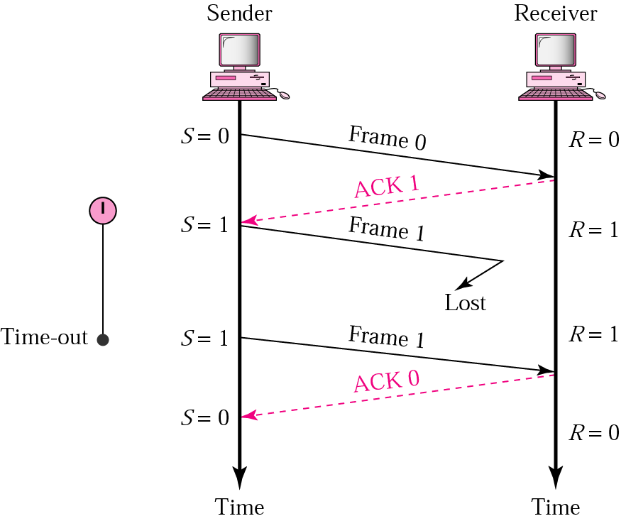
Stop-and-Wait ARQ, lost ACK frame
When a receiver receives a damaged frame, it discards it and keeps its value of R.
After the timer at the sender expires, another copy of frame 1 is sent.

Slide 16
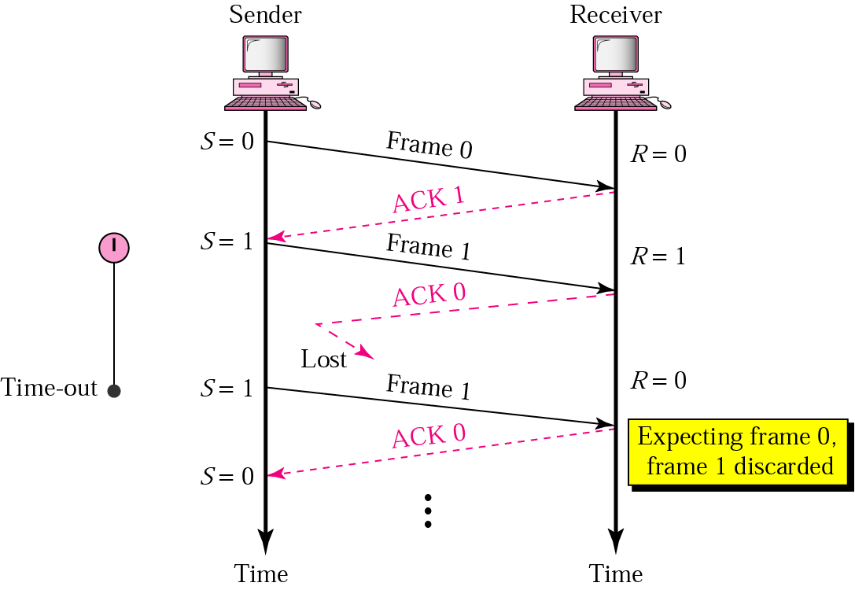
Stop-and-Wait, lost ACK frame
If the sender receives a damaged ACK, it discards it.
When the timer of the sender expires, the sender retransmits frame 1.
Receiver has already received frame 1 and expecting to receive frame 0 (R=0). Therefore it discards the second copy of frame 1.

Slide 17
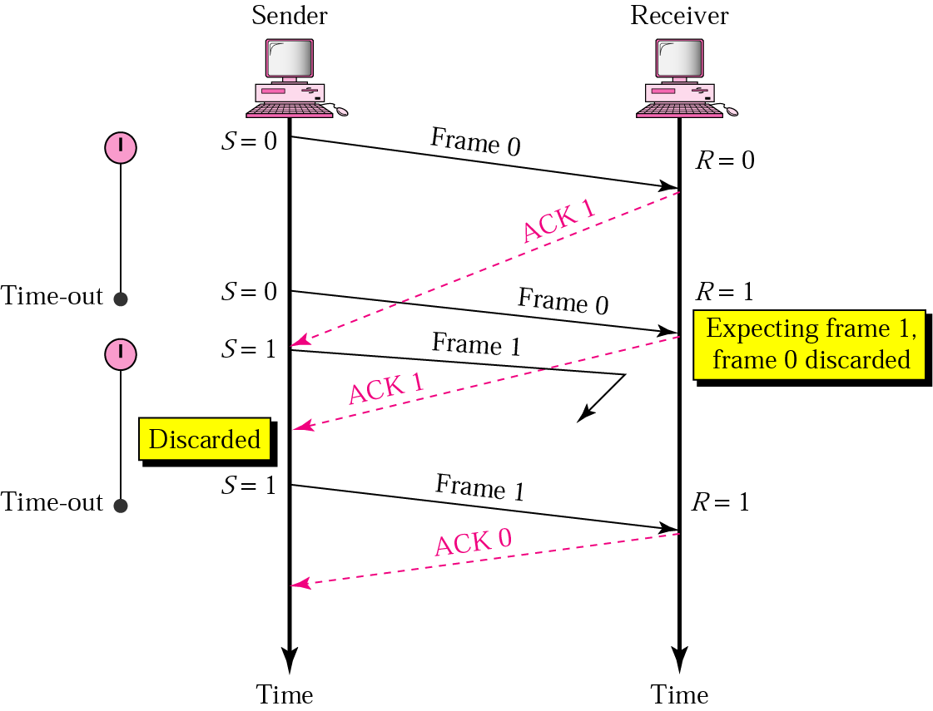
Stop-and-Wait, delayed ACK frame
The ACK can be delayed at the receiver or due to some problem
It is received after the timer for frame 0 has expired.
Sender retransmitted a copy of frame 0. However, R =1 means receiver expects to see frame 1. Receiver discards the duplicate frame 0.
Sender receives 2 ACKs, it discards the second ACK.

Slide 18
Error correction in Stop-and-Wait ARQ is done by keeping a copy of the sent frame and retransmitting of the frame when the timer expires.
In Stop-and-Wait ARQ, we use sequence numbers to number the frames.
The sequence numbers are based on modulo-2 arithmetic.
In Stop-and-Wait ARQ, the acknowledgment number always announces in modulo-2 arithmetic the sequence number of the next frame expected.

Slide 19
Example 1 Stop & Wait ARQ
Figure 11.11 shows an example of Stop-and-Wait ARQ. Frame 0 is sent and acknowledged. Frame 1 is lost and resent after the time-out. The resent frame 1 is acknowledged and the timer stops. Frame 0 is sent and acknowledged, but the acknowledgment is lost. The sender has no idea if the frame or the acknowledgment is lost, so after the time-out, it resends frame 0, which is acknowledged.

Slide 20
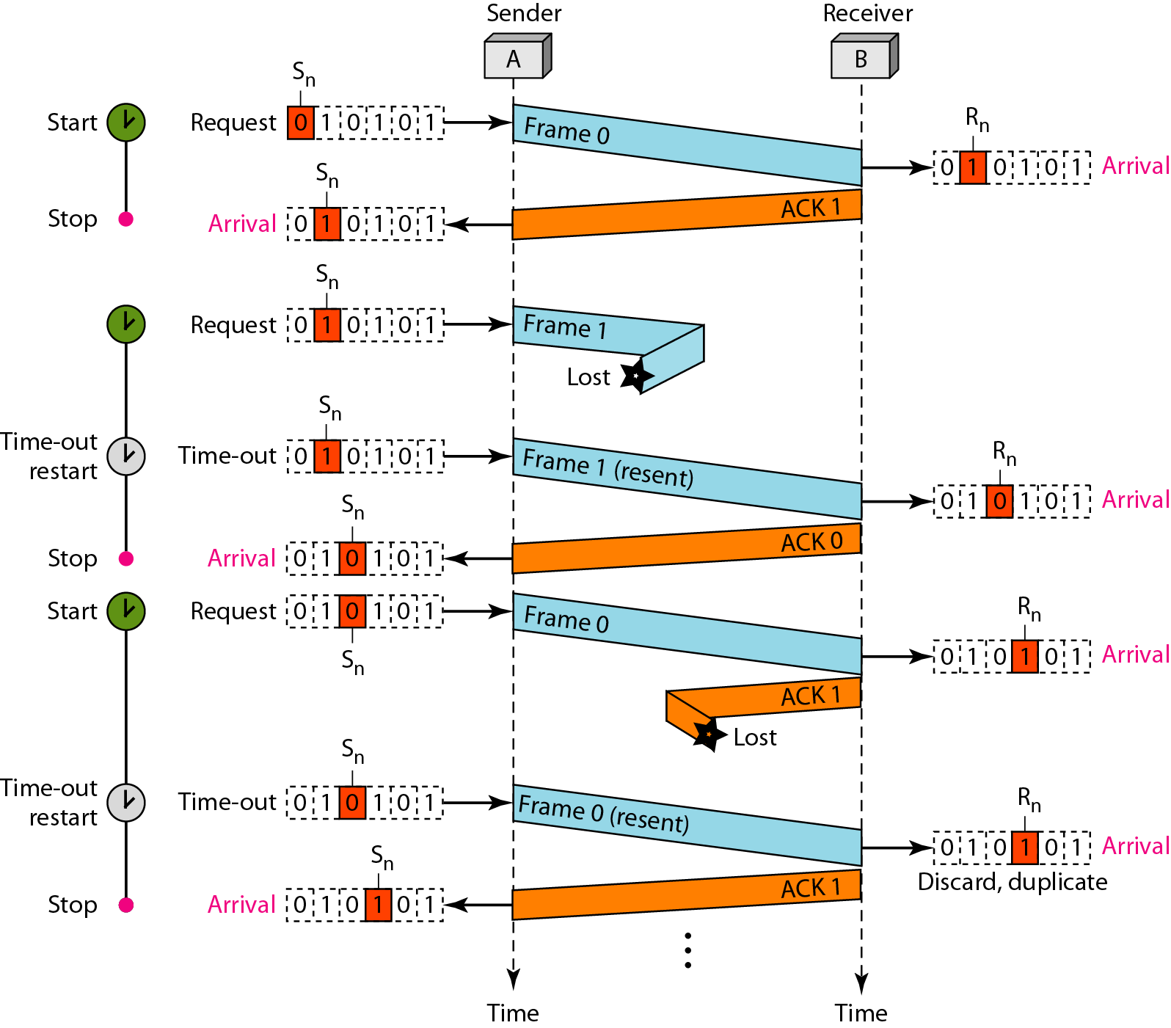
Flow diagram for Example 1 Stop & Wait ARQ

Slide 21
Example 2 Stop & Wait ARQ
Assume that, in a Stop-and-Wait ARQ system, the bandwidth of the line is 1 Mbps, and 1 bit takes 20 ms to make a round trip. What is the bandwidth-delay product? If the system data frames are 1000 bits in length, what is the utilization percentage of the link?
Solution
The bandwidth-delay product is

Slide 22
Example 2 Stop & Wait ARQ
The system can send 20,000 bits during the time it takes for the data to go from the sender to the receiver and then back again. However, the system sends only 1000 bits. We can say that the link utilization is only 1000/20,000, or 5 percent. For this reason, for a link with a high bandwidth or long delay, the use of Stop-and-Wait ARQ wastes the capacity of the link.

Slide 23
Example 3 Stop & Wait ARQ
What is the utilization percentage of the link in Example 11.4 if we have a protocol that can send up to 15 frames before stopping and worrying about the acknowledgments?
Solution
The bandwidth-delay product is still 20,000 bits. The system can send up to 15 frames or 15,000 bits during a round trip. This means the utilization is 15,000/20,000, or 75 percent. Of course, if there are damaged frames, the utilization percentage is much less because frames have to be resent.

Slide 24
Disadvantage of Stop-and-Wait
In stop-and-wait, at any point in time, there is only one frame that is sent and waiting to be acknowledged.
This is not a good use of transmission medium.
To improve efficiency, multiple frames should be in transition while waiting for ACK.
Two protocol use the above concept,
Go-Back-N ARQ
Selective Repeat ARQ

Slide 25
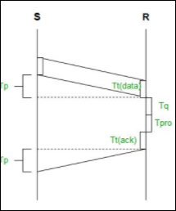
Efficiency of Stop and Wait Protocol
Stop and Wait is a flow control protocol. In which the sender sends one packet and waits for the receiver to acknowledge and then it will send the next packet. In case if the acknowledgment is not received, the sender will retransmit the packet. This is the simplest one and easy to implement. but the main disadvantage is the efficiency is very low.

Slide 26
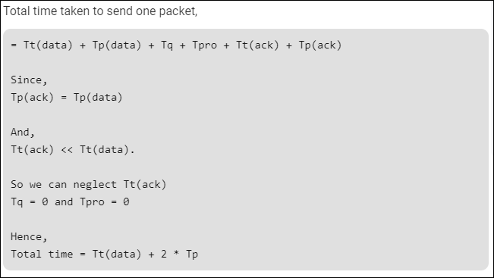
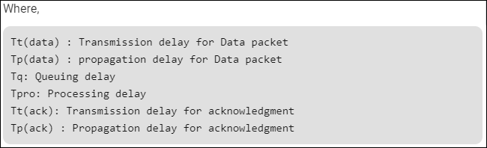

Slide 27
Efficiency (η)=
= Useful time / Total cycle time.
= Tt / (Tt + 2*Tp)
= 1 / (1+2*(Tp/Tt))
= 1 / (1+2*a) where, a = Tp / Tt
Throughput: Number of bits send per second, which is also known as Effective Bandwidth or Bandwidth utilization.
Throughput = η * BW
where, BW is BandWidth

Slide 28
Problem-01:
If the bandwidth of the line is 1.5 Mbps, RTT is 45 msec and packet size is 1 KB, then find the link utilization in stop and wait.
Solution-
Given-
Bandwidth = 1.5 Mbps, RTT = 45 msec & Packet size = 1 KB
Calculating Transmission Delay-
Transmission delay (T_{t})
= Packet size / Bandwidth
= 1 KB / 1.5 Mbps
= (2¹⁰ x 8 bits) / (1.5 x 10⁶ bits per sec)
= 5.461 msec

Slide 29
Calculating Propagation Delay-
Propagation delay (T_{p}) = Round Trip Time / 2
= 45 msec / 2 = 22.5 msec
Calculating Value Of ‘a’-
a = T_{p} / T_{t}
a = 22.5 msec / 5.461 msec
a = 4.12
Calculating Link Utilization-
Link Utilization or Efficiency (η)
= 1 / 1+2a
= 1 / (1 + 2 x 4.12)
= 1 / 9.24
= 0.108
= 10.8 %

Slide 30
Problem-02:
A channel has a bit rate of 4 Kbps and one way propagation delay of 20 msec. The channel uses stop and wait protocol. The transmission time of the acknowledgement frame is negligible. To get a channel efficiency of at least 50%, the minimum frame size should be-
80 bytes
80 bits
160 bytes
160 bits

Slide 31
Solution-
Given-
Bandwidth = 4 Kbps
Propagation delay (T_{p}) = 20 msec
Efficiency >= 50%
Let the required frame size = L bits.
Calculating Transmission Delay-
Transmission delay (T_{t})
= Packet size / Bandwidth
= L bits / 4 Kbps

Slide 32
Calculating Value Of ‘a’-
a = T_{p} / T_{t}
a = 20 msec / ( L bits / 4 Kbps)
a = (20 msec x 4 Kbps) / L bits
Condition For Efficiency To Be At least 50%-
For efficiency to be at least 50%, we must have-
1 / 1+2a >= 1/2
a <= 1/2
Substituting the value of ‘a’, we get-
(20 msec x 4 Kbps) / L bits <= 1/2
L bits >= (20 msec x 4 Kbps) x 2
L bits >= (20 x 10⁻³ sec x 4 x 10³ bits per sec) x 2
L bits >= 20 x 4 bits x 2
L >= 160
From here, frame size must be at least 160 bits.
Thus, Correct Option is (D).

